Slide 1
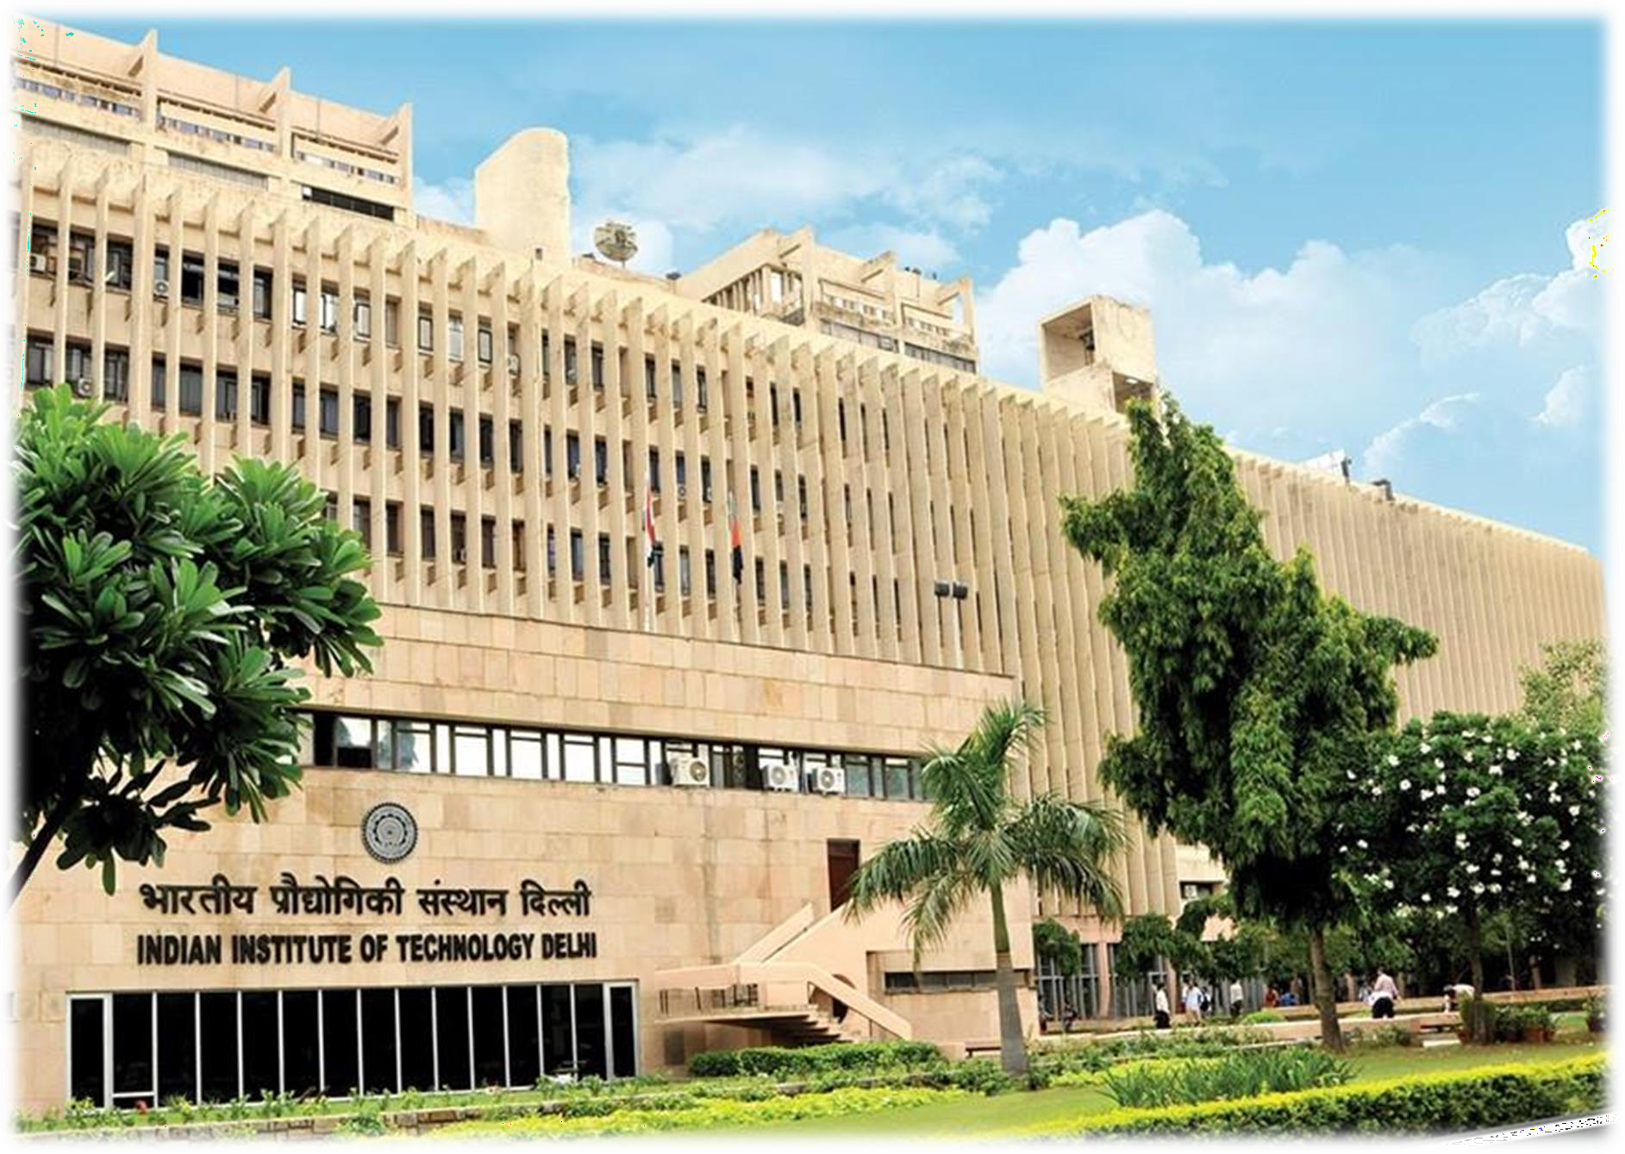

Project Update
Name: Sanjyot KADU
Kit: 2
Project Name:
Odometry with trajectory planning (IMU+encoders) (Advanced)
Date: 16-08-2026
EXECUTIVE PROGRAMME IN ROBOTICS

Slide 2

Project Update
1. Structure
Motor Movements
PID for Wheel speed using Encoder Feedback
Proportional Algorithm for IMU for heading straight and direction correction
2. Electronics (Sensors and actuators)
Teensy 4.1, FLYSKY RX and TX
IMU
ENCODER
3. Interfacing (Coding and working)
JOYSTICK Gives X and Y and W -> Kinematics → Power calculation→ Wheel movement
ENOODER FEED BACK → PID with Target speed → Power calculation→ Wheel movement
IMU HEADING Correction with Proportional algorithm → Power calculation→ Wheel movement
Way point navigation using Inverse Kinamitics
4. Testing :
https://www.youtube.com/watch?v=gaknL4u0YpY
https://www.youtube.com/watch?v=SzrNauayHow

Slide 3
Project Update
CODE :
https://github.com/sanjyotkadu/TurtleBotIITDProject/tree/TB_001_002_working
Issues faced in detail:
- The Bot is taking turn little ahead of target position this needs to be corrected
- Future implementation for Obstruction avoidance and A* algorithm
-movement using GPS sensor
Help needed for: Any suggestion ?

Slide 4


EXECUTIVE PROGRAMME IN ROBOTICS

